Slide 1
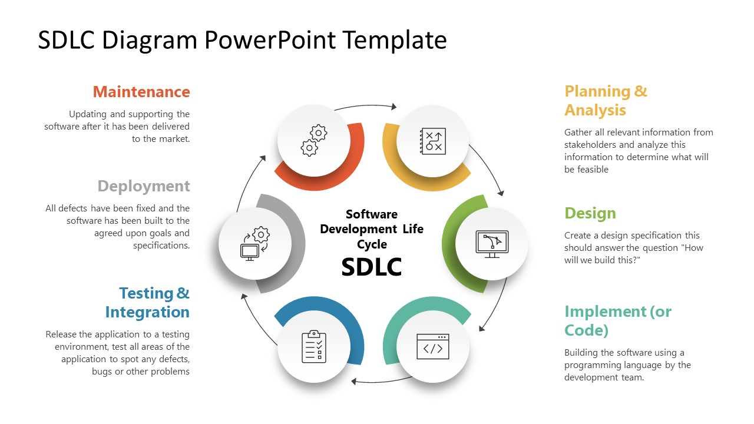
Software Development Life Cycle (SDLC)

Slide 2
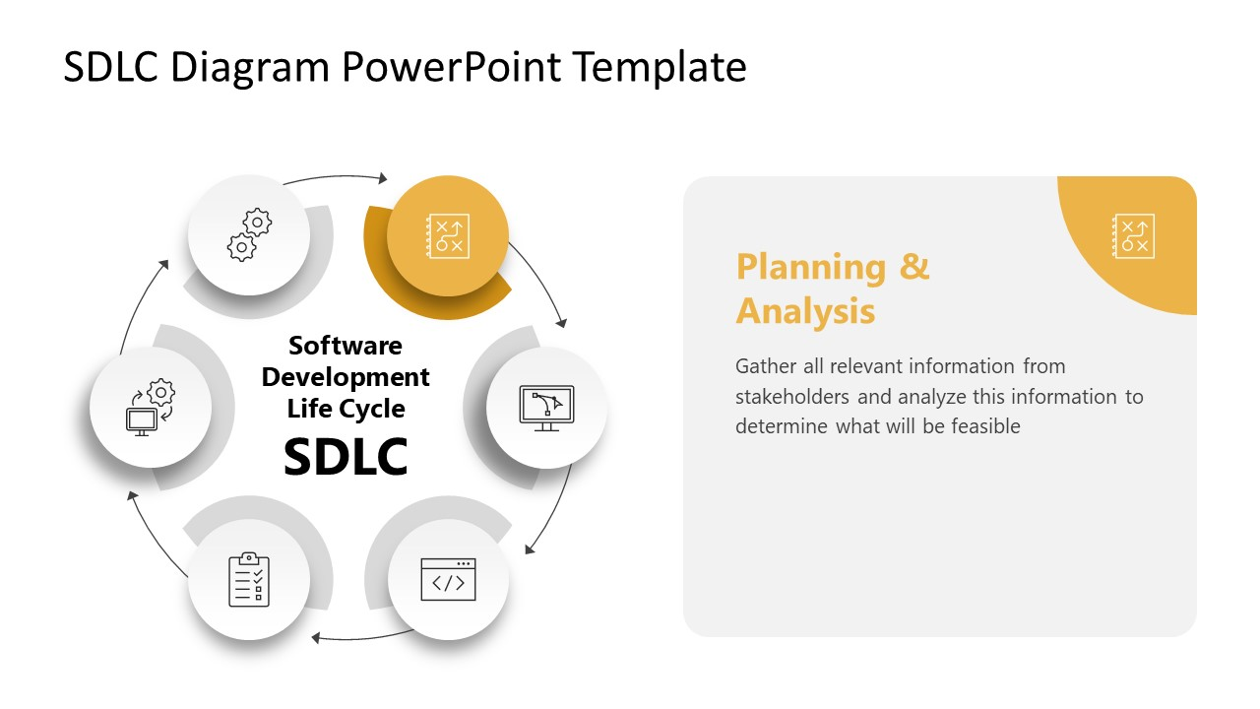
Software Development Life Cycle (SDLC)

Slide 3
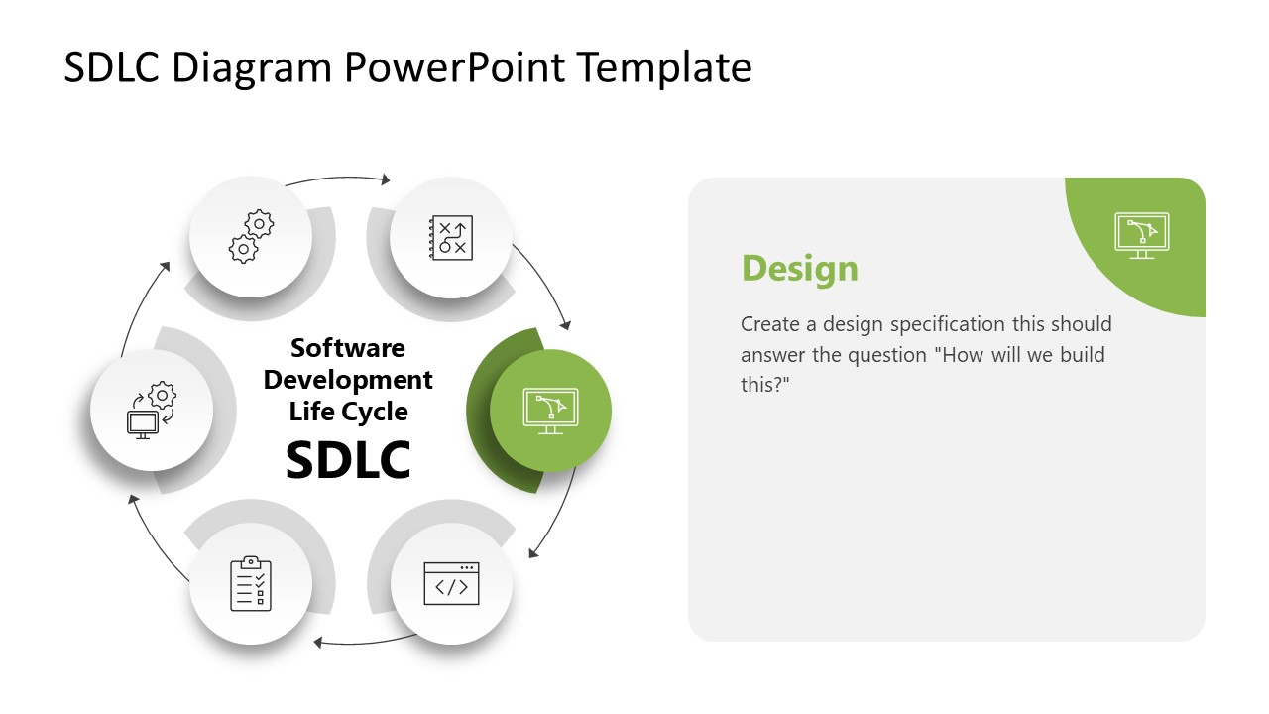
Software Development Life Cycle (SDLC)

Slide 4
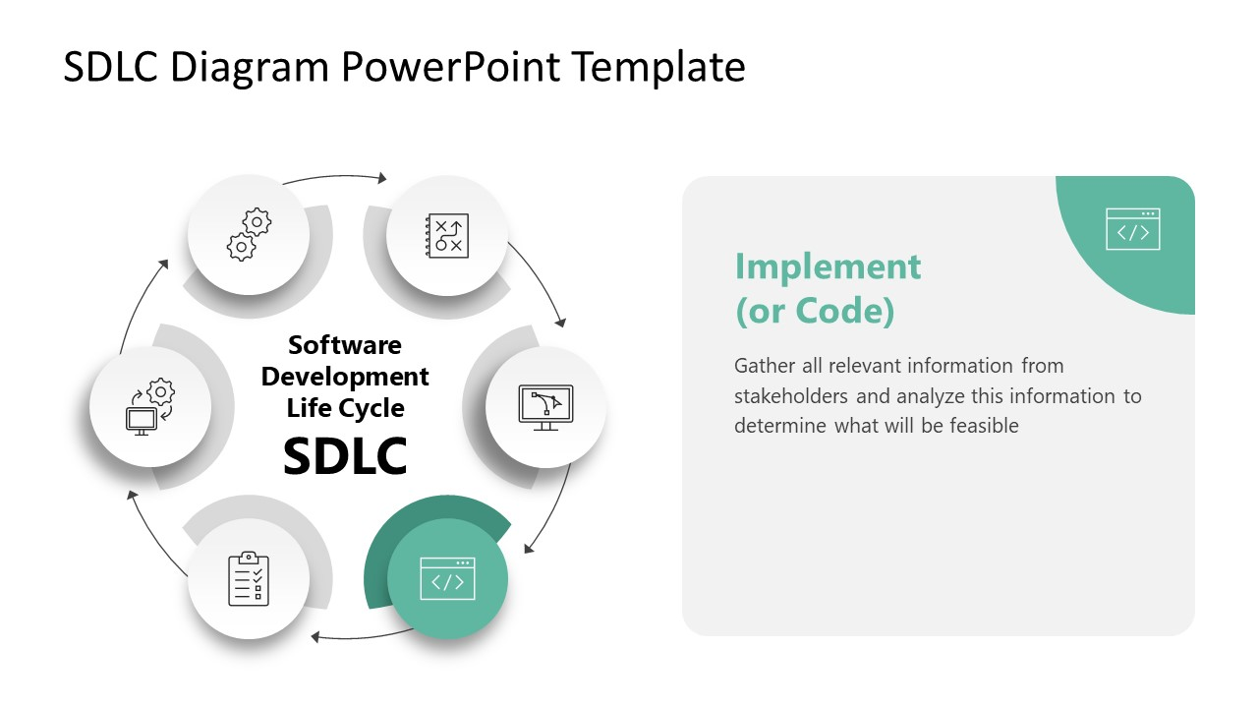
Software Development Life Cycle (SDLC)

Slide 5
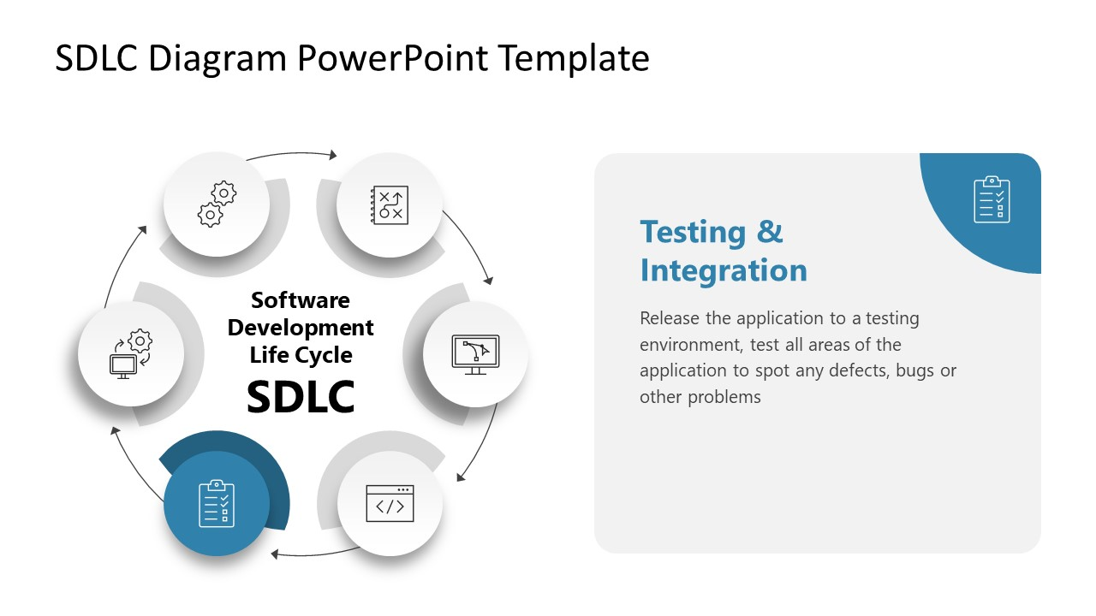
Software Development Life Cycle (SDLC)

Slide 6
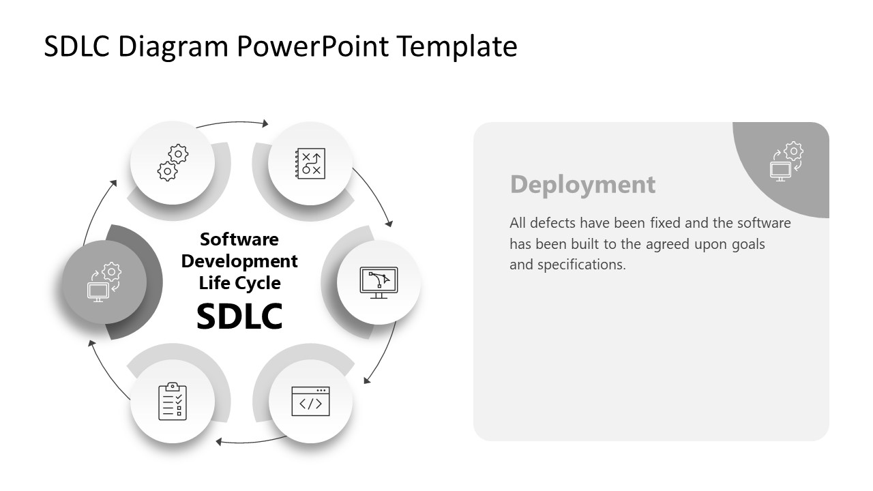
Software Development Life Cycle (SDLC)

Slide 7
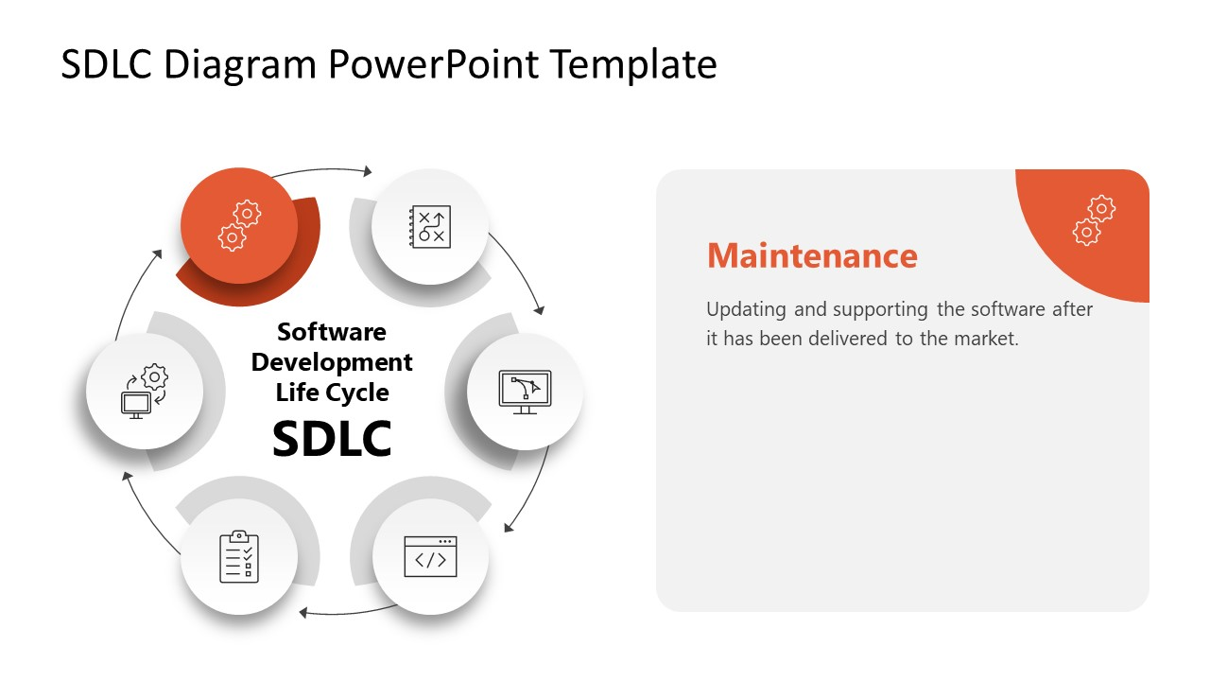
Software Development Life Cycle (SDLC)

